Slide 1
Activity 2: PROPERTIES AND APPLICATIOON OF 2D FOURIER TRANSFORM PART 2
Genesis Vertudez – 202003099
App Physics 157 - Computational Analysis and Modeling in Physics
Submitted to Dr. Maricor Soriano; Mx. Rene Principe Jr.

Slide 2
OBJECTIVES
Use Fourier transform to manipulate images
Convolve images with patterns to apply it to them
Convolve images with filters to improve them
Use Fourier transform to locate certain patterns in images

Slide 3






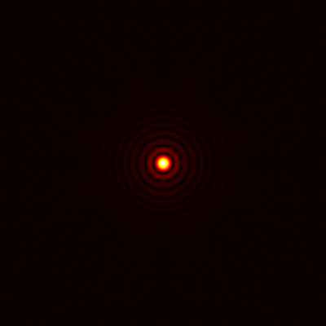
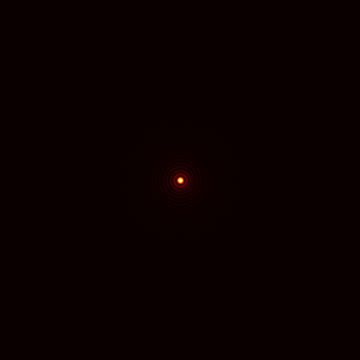
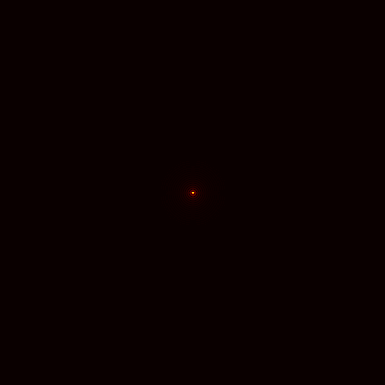
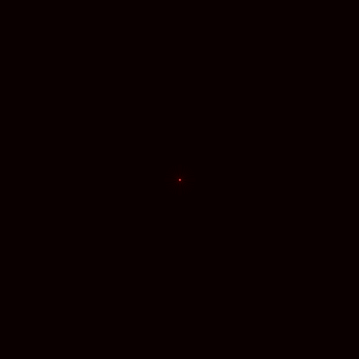
RESULTS & ANALYSIS
Fourier transform of circles
The Fourier transform of a circle are concentric circles. The larger the radius of the circle, the smaller the Fourier transform.
Codes and files: https://github.com/genvert/AP_157_FX-2_Vertudez/tree/main/Activity%202%20Part%202

Slide 4

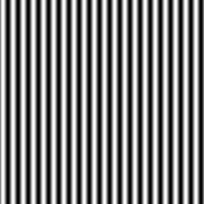

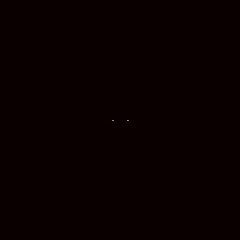
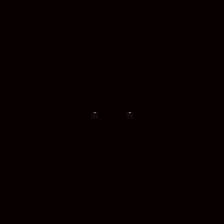

RESULTS & ANALYSIS
Fourier transform of sinusoids
The Fourier transform of a sinusoid are two points, which correspond to two Dirac deltas. The frequency is directly proportional to the separation distance of the points.
Codes and files: https://github.com/genvert/AP_157_FX-2_Vertudez/tree/main/Activity%202%20Part%202

Slide 5
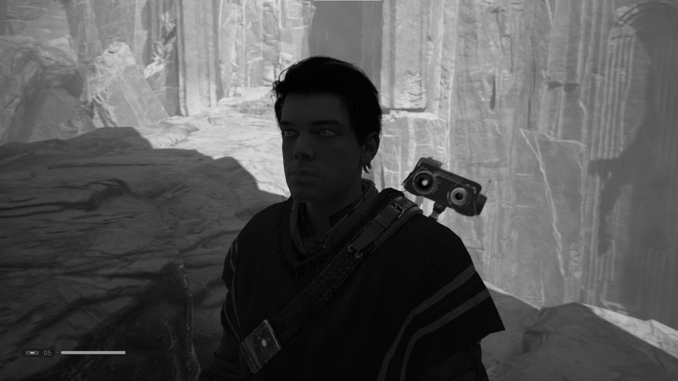
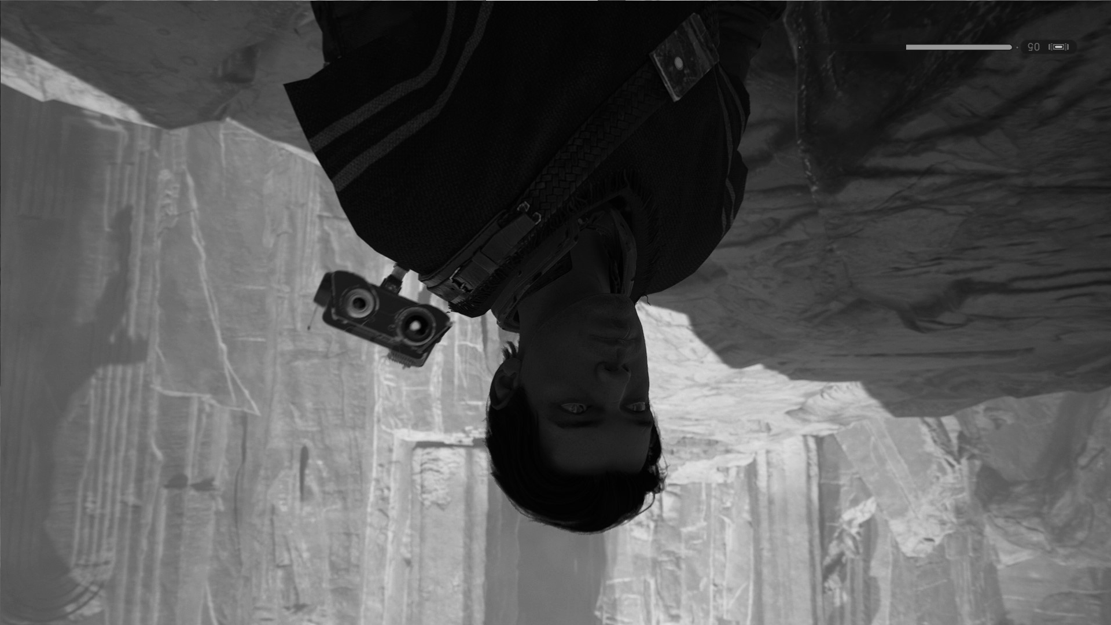

RESULTS & ANALYSIS
fft of fft VS. ifft of fft
Original image fft of fft ifft of fft
Taking the fft of fft of an image rotates it 180 degrees.
Taking the ifft of fft returns the original image, which makes sense since they are inverse operator of each other.
Codes and files: https://github.com/genvert/AP_157_FX-2_Vertudez/tree/main/Activity%202%20Part%202

Slide 6
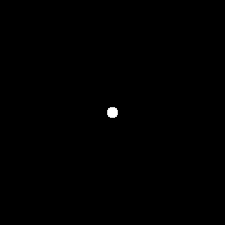




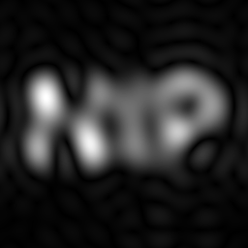
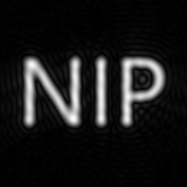
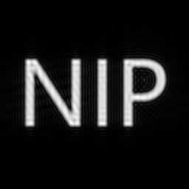



RESULTS & ANALYSIS
Convolving an image with another
Convolving two functions is equal to multiplying their Fourier transforms
In this case, each pixel of the image acts as a Dirac delta function. Convolving it with different images (circles and sinusoid) essentially copies their the Fourier transform to each pixel.
From previous results, smaller circle has larger diffraction pattern as Fourier transform, which makes the NIP image blurry. Sinusoids has two points spaced from the center as Fourier transform, which makes the NIP image duplicate with space from the center.
Codes and files: https://github.com/genvert/AP_157_FX-2_Vertudez/tree/main/Activity%202%20Part%202

Slide 7
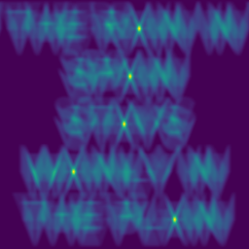
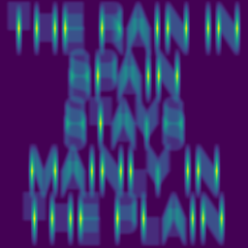
RESULTS & ANALYSIS
Correlating an image with another
Correlating two functions is equal to multiplying their Fourier transforms, but this time the other is complex conjugate.
Correlation measures the degree of similarity of the functions
The results make sense since when the phrase was correlated with a letter, the result show the points where the functions (in this case images) are similar
Codes and files: https://github.com/genvert/AP_157_FX-2_Vertudez/tree/main/Activity%202%20Part%202

Slide 8
REFLECTION
This activity was straightforward so I was able to follow it easily.
It is cool that the pixels can act as Dirac delta functions such that other images are copied to each pixel when convolved.
I managed to do it on time this time.
I give myself a 10/10.

Slide 9
SELF-GRADE
Technical correctness: 35/35
I am confident that I understood how to use ImageJ to extract feature from images, and have applied it.
Quality of presentation: 35/35
I have explained each step, and images are clear and concise.
Self-reflection: 30/30
Even though I was slacking in this subject for a while, I managed to get back on track. The topics are really fun and interesting. It helped me understand the ideas behind image tools such as smartphone cameras, Photoshop, etc.
Initiative: 10/10
I used an extra image for extraction.

